Slide 1







Enterprise Blockchain Developers (Intermediate)
In support of
Powered By

Slide 2
Outline
What are Node and Express js
MVC Model
MVC Code Demo Requirements: Registration
SQL
Problem Without Model
Sequelize
JWT
Form, File upload, Pass params
© 2017-2020 SmartMesh Foundation Pte. Ltd. | MeshBox Foundation Pte. Ltd.

Slide 3
What are Node and Express js
Nodejs:
Node.js is an open source server environment
HTTP Module
File System Module
URL Module: splits up a web address into readable parts
Events Module: event emite on etc.
Node.js runs on various platforms (Windows, Linux, Unix, Mac OS X, etc.)
Node.js uses JavaScript on the server
Expressjs:
Express is a small framework that sits on top of Node.js’s web server functionality to simplify its APIs and add helpful new features. It makes it easier to organize your application’s functionality with middle ware and routing. It adds helpful utilities to Node.js’s HTTP objects. It facilitates the rendering of dynamic HTTP objects

Slide 4
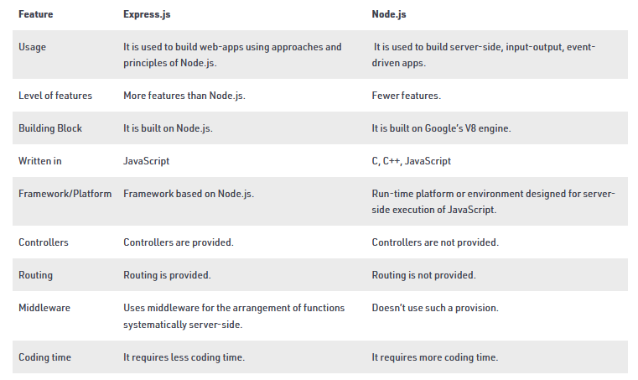
What are Node and Express js
Deffierence

Slide 5
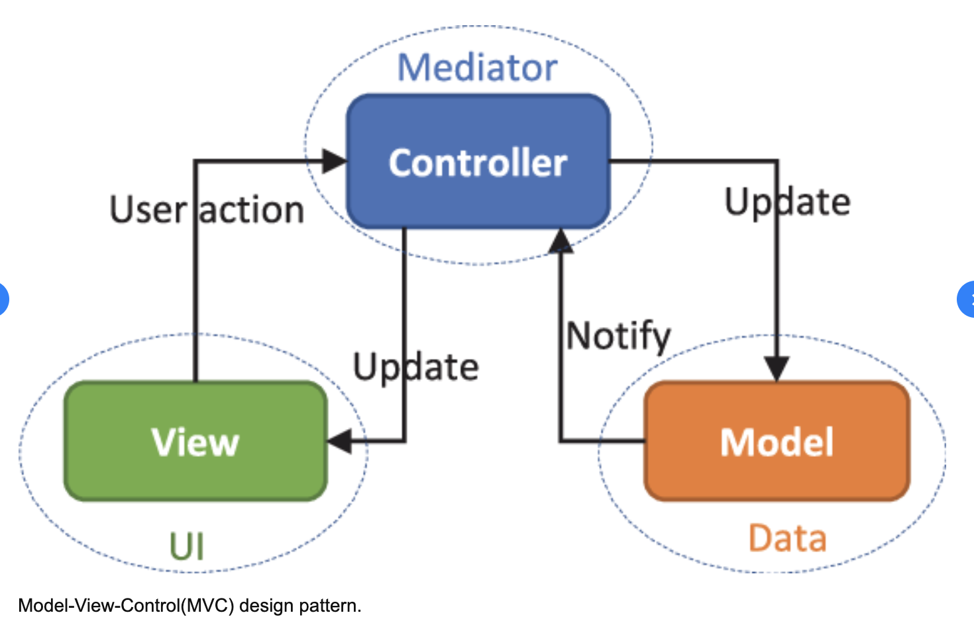
MVC Model
Model-View-Control

Slide 6
MVC Model
Model
The central component of the pattern. It is the application's dynamic data structure, independent of the user interface.[5] It directly manages the data, logic and rules of the application.
View
Any representation of information such as a chart, diagram or table. Multiple views of the same information are possible, such as a bar chart for management and a tabular view for accountants.
Controller
Accepts input and converts it to commands for the model or view

Slide 7
MVC Model
MVC Model Programming Steps: Node and Express js
Steps:
1. Setting up an Express App
2. Adding middleware
3. Setting up database connection
Iterating process:
3. Writing routes and controller
4. Defining corresponding data models
5. Writing corresponding html

Slide 8
MVC Code Demo Requirements: Registration
Requirements:
1. Design database models: Using SQLite3
2. Write Login, Logout, and Dashboard home page
3. Write controller to interact with database through Models and rendering views
Do Code Demo Later

Slide 9
SQL
Query:
Select * from table_name
Update:
INSERT INTO users (id, name, email, password, createdAt, updatedAt)
VALUES (3, "bing", "we@qq.com", "123","","");
Deletion:
DELETE from users WHERE name = "bing";
count, distinct, max, min, sum
select keyword() from users where xxx;
(code demo on database.sqlite)

Slide 10
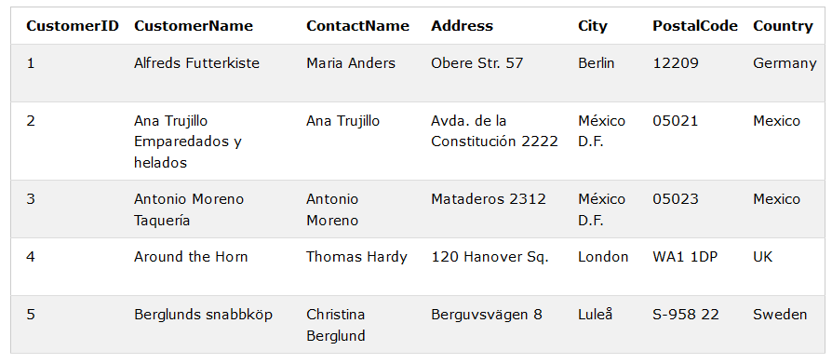
SQL
Ordering
SELECT column1, column2, ...
FROM table_name
ORDER BY column1, column2, ... ASC|DESC;

Slide 11
SQL
Grouping
SELECT column_name(s) / max(column_name)
FROM table_name
WHERE condition
GROUP BY column_name(s)
ORDER BY column_name(s);

Slide 12
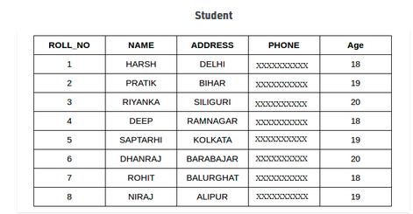
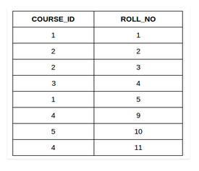
SQL
INNER JOIN, LEFT JOIN, RIGHT JOIN, FULL JOIN

Slide 13
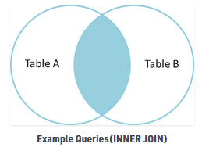
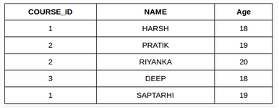
SQL
INNER JOIN
SELECT table1.column1,table1.column2,table2.column1,....
FROM table1
INNER JOIN table2
ON table1.matching_column = table2.matching_column;

Slide 14
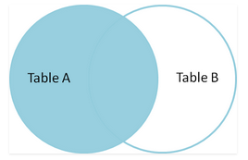
SQL
Left JOIN
SELECT table1.column1,table1.column2,table2.column1,....
FROM table1
LEFT JOIN table2
ON table1.matching_column = table2.matching_column;

Slide 15
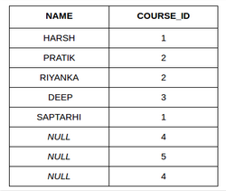
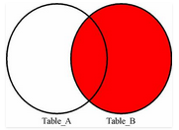
SQL
RIGHT JOIN
SELECT Student.NAME,StudentCourse.COURSE_ID
FROM Student
RIGHT JOIN StudentCourse
ON StudentCourse.ROLL_NO = Student.ROLL_NO;

Slide 16
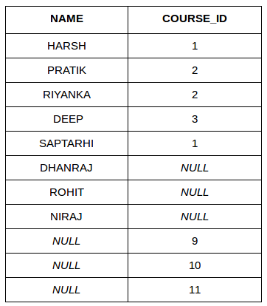
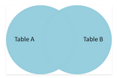
SQL
Full JOIN
SELECT Student.NAME,StudentCourse.COURSE_ID
FROM Student
FULL JOIN StudentCourse
ON StudentCourse.ROLL_NO = Student.ROLL_NO;

Slide 17
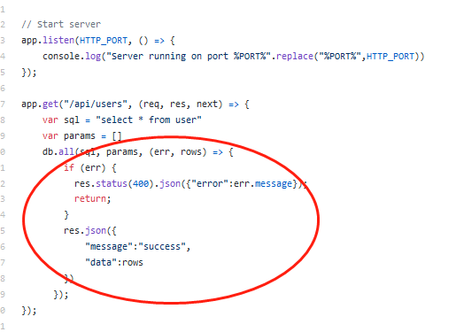
Problem Without Model
https://github.com/onebit256/node-express-rest-api-example (Explain the code)
Without using Model
If we want to change the data query logic, we have to change the controller's logic

Slide 18
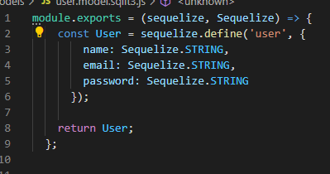
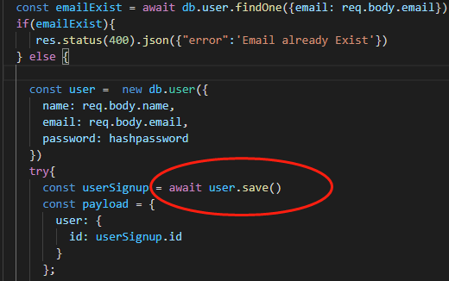
Problem Without Model
https://github.com/onebit256/node-express-react-demo-project (Explain the code) With Model
*
if we want to change the logic of
data save function, we don't neet to
change the controller's logic
program is more readable
easier to understand other's code

Slide 19
Sequelize
What is Sequelize ?
Sequelize is a promise-based ORM for Node.js v4 and upwards. It supports the dialects PostgreSQL, MySQL, SQLite and MSSQL and features solid transaction support, relations, read replication and more.
What is ORM ?
An ORM is known as Object Relational Mapper
ORMs save time in writing raw SQL queries thereby reducing development time.
out of box query
Example
select *from user => user.findAll()
select * from user where => user.find()

Slide 20
Request Type
Get Request (code demo)
the parameters are taken in url
Post Request(code demo)
the parameters are taken in request playload
demo Postman, project interaction

Slide 21
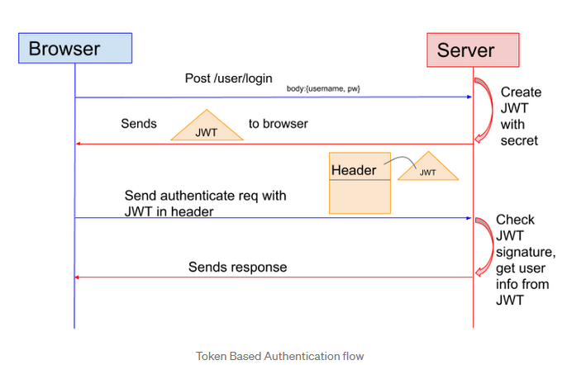
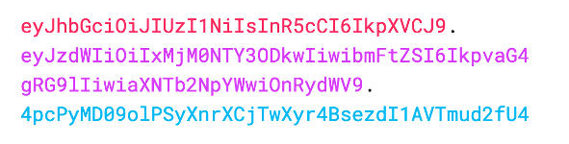
JsonWebToken(JWT)
What is JWT

Slide 22
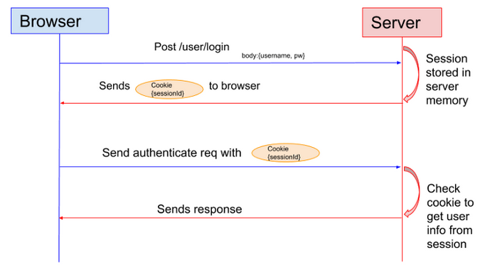
JsonWebToken(JWT)
JWT vs Session
Drawback: the Session cannot be verified cross servers for the cluster, unless stored in database

Slide 23
MVC Code Demo Requirements: Registration
Requirements:
1. Design database models: Using SQLite3
2. Write Login, Logout, and Dashboard home page
3. Write controller to interact with database through Models and rendering views
Code Demo Now
How to write a program from scratch

Slide 24
MVC Model
Model
The central component of the pattern. It is the application's dynamic data structure, independent of the user interface.[5] It directly manages the data, logic and rules of the application.
View
Any representation of information such as a chart, diagram or table. Multiple views of the same information are possible, such as a bar chart for management and a tabular view for accountants.
Controller
Accepts input and converts it to commands for the model or view

Slide 25
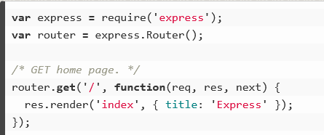
Send Parameters to the View
Code Demo
Compare a normal program with a api program

Slide 26
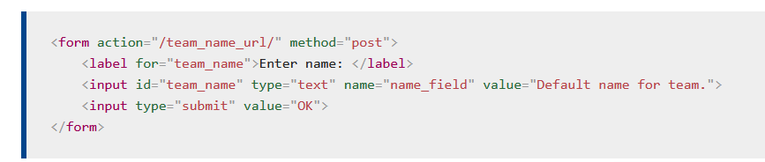
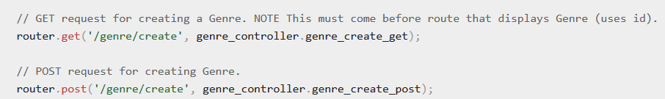
Form
1 specify Router
2 specify the request type, usually POST for Forms
Form will take inputs value as parameters to send to the server
action should match routes, then the route will call the controller function to handle the request. In this case, put action = /genre/create

Slide 27
File Upload
https://www.geeksforgeeks.org/file-uploading-in-node-js/

